Slide 1
TERRAIN RECOGNITION USING YOLOv8
PRESENTED BY: SREE LEKHA S
REGISTER NO : au711721243105
DEPARTMENT : KGISL Institute of Technology
3/21/2024 Annual Review

Slide 2
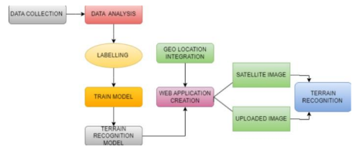
PROJECT TITLE TERRAIN RECOGNITION USING YOLOv8
3/21/2024 Annual Review

Slide 3


AGENDA 1. Problem statement 2. Project overview 3. Who are the end users? 4. Solution and its value proposition 5. The wow in my solution 6. Modelling 7. Result 8. Conclusion
3/21/2024 Annual Review

Slide 4

PROBLEM STATEMENT
Existing terrain recognition methods utilizing deep learning, particularly CNNs, often lack the ability to provide comprehensive information beyond basic terrain types (sandy, rocky, grassy, marshy). Moreover, they do not adequately address implicit quantities crucial for environment perception, such as roughness and slipperiness. This limitation hinders the effectiveness of applications like autonomous vehicles and environmental monitoring, which require precise terrain characterization. Therefore, there is a pressing need for an advanced vision-based approach that integrates CNNs with methods to extract and incorporate implicit quantities, enabling accurate and detailed terrain recognition for enhanced environmental perception in various domains.
3/21/2024 Annual Review

Slide 5

PROJECT OVERVIEW The project aims to develop an advanced terrain recognition system by integrating deep learning techniques with geolocation services. Using Convolutional Neural Networks (CNNs), the system will be capable of real-time identification of diverse terrain types such as sandy, rocky, grassy, and marshy regions. Additionally, the system will provide implicit quantities information like roughness and slipperiness, essential for high-level environmental perception. This will enable applications such as autonomous vehicles, precision agriculture, and environmental monitoring to make informed decisions based on accurate terrain characterization. The project also includes the development of a user-friendly interface to facilitate seamless deployment on mobile platforms, allowing users to analyze terrain features captured through device cameras and input geographical coordinates for precise terrain information retrieval.
3/21/2024 Annual Review

Slide 6

WHO ARE THE END USERS?
Autonomous Vehicle Manufacturers
Military and Defense
Environmental Monitoring Agencies
Precision Agriculture
Search and Rescue Teams
Training and Simulation
Geographic Information Systems (GIS) Professionals
Outdoor Recreation Enthusiasts
Aerial Drones
3/21/2024 Annual Review

Slide 7

SOLUTION AND ITS VALUE PROPOSITION
Solution:
The solution employs a YOLOv8 model trained with a diverse dataset to recognize terrain types in real-time. Fine-tuning techniques and dataset augmentation enable precise identification of sandy, rocky, grassy, and marshy regions. The model also provides implicit quantities information such as slipperiness and roughness, crucial for environmental perception. This approach enhances terrain recognition capabilities, benefiting applications like autonomous vehicles, precision agriculture, and environmental monitoring.
Value Proposition:
Accurate Terrain Recognition
Comprehensive Environmental Perception
Real-Time Analysis
Versatile Applications
3/21/2024 Annual Review

Slide 8

THE WOW IN MY SOLUTION
The wow factor in our solution lies in its ability to seamlessly integrate advanced deep learning techniques with geolocation services, resulting in a comprehensive and highly accurate terrain recognition system. By harnessing the power of YOLOv8 and fine-tuning techniques, we achieve real-time identification of diverse terrain types with exceptional precision. Furthermore, the inclusion of implicit quantities information such as slipperiness and roughness enhances environmental perception, making our solution invaluable for applications requiring detailed terrain analysis and informed decision-making.
3/21/2024 Annual Review

Slide 9
MODELLING
Data Collection:
Gathered diverse terrain images from various sources such as satellite imagery, aerial photography, and ground-level photographs.
Selected images to represent different terrain types including sandy, rocky, grassy, and marshy regions.
2. Data Preprocessing:
Conducted preprocessing tasks such as resizing, normalization, and augmentation to enhance the dataset's quality and diversity.
Augmented the dataset using techniques like rotation, flipping, and brightness adjustments to increase its variability.
3. Data Annotation:
Annotated the collected images to create a labeled dataset using tools like Roboflow. Annotated each image with bounding boxes around the terrain objects, indicating their location and type.
3/21/2024 Annual Review

Slide 10
4. Data Creation:
Processed and formatted the annotated data to create a dataset suitable for training the model.
Divided the dataset into training, validation, and test sets to ensure accurate model evaluation.
5. Model Training:
Utilized the YOLOv8 architecture for terrain recognition, leveraging its object detection capabilities.
A Trained the model on the annotated dataset using fine-tuning techniques to improve its accuracy and generalization.
6. Evaluation and Validation:
Evaluated the trained model on the validation set to assess its performance and fine-tuned hyperparameters if necessary.
Utilized validation metrics such as precision, recall, and F1-score to gauge the model's effectiveness in terrain recognition.
7. Deployment:
Deployed the model for real-time inference.
Integrated the application with geolocation services to provide accurate terrain information and implicit quantities like slipperiness and roughness.
Ensured scalability and adaptability of the deployed system for various applications such as autonomous vehicles, precision agriculture, and environmental monitoring.
3/21/2024 Annual Review

Slide 11
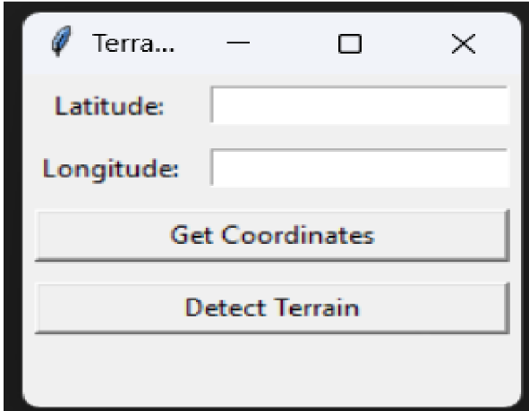
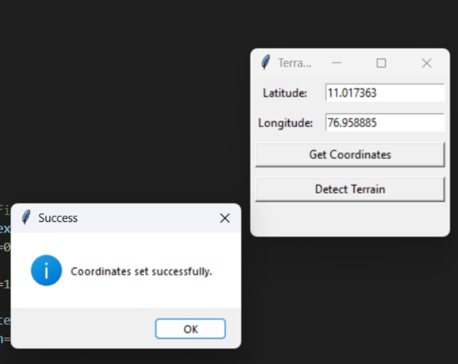
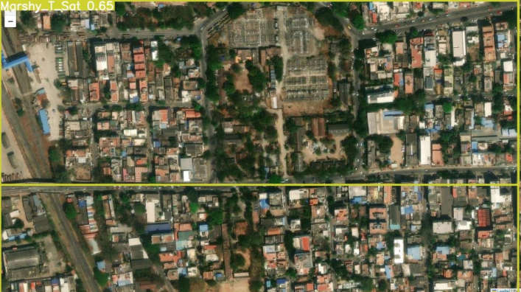
RESULT
3/21/2024 Annual Review

Slide 12
CONCLUSION
In conclusion, our project presents a robust terrain recognition system that integrates advanced deep learning techniques with geolocation services. Through the utilization of the YOLOv8 model and fine-tuning methods, we achieved real-time and accurate identification of diverse terrain types, including sandy, rocky, grassy, and marshy regions. Additionally, the system provides valuable implicit quantities information such as slipperiness and roughness, enhancing environmental perception for various applications. The developed application interface further facilitates seamless deployment on mobile platforms, offering users a user-friendly experience. Overall, our solution offers a comprehensive and effective solution for terrain analysis, benefiting industries such as autonomous vehicles, precision agriculture, and environmental monitoring.

